Slide 1
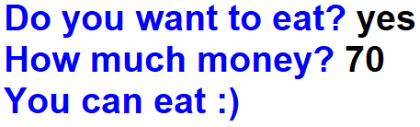
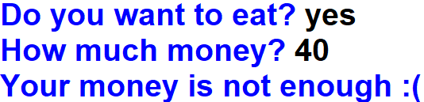


1.When a user is asked “Do you want to eat?”, if the user answers “yes”, then you should ask the user “How much money?”. If the user has 50 manats or more than that, output "You can eat“, else output "Your money is not enough". If answered “no”, output "Thank you!".
Output:
Output:
Output:
Output:

Slide 2

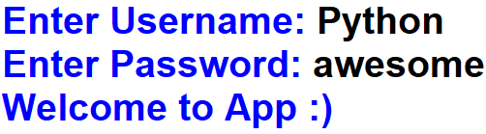
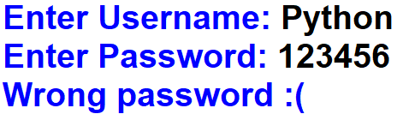
2. Ask from a user the username and password and accept if they are correct.
Output:
Output:
Output:

Slide 3
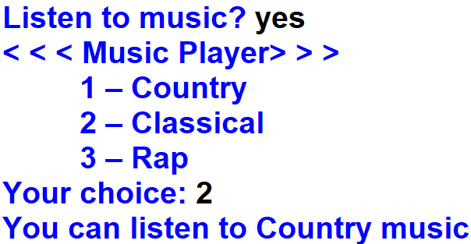


Problem-3:
Output:
Output:
Output:

Slide 4


